Slide 1
Intelligence Augmentation @Smart Stadiums
Remark Holdings Inc.

Slide 2
About Us
Industry leaders in AI Technology, Security, and Safety
Our Team
Robert Gatchell, COO
Shing Tao, Chairman & CEO
Jason Wei, CTO
Kai Tao, CSO
DeMeaky Williams, CRO
Kirk Hooten, DSO
We are a global leader in Video Analytics with one of the most intelligent, reliable, and fast AI platforms. Our headquarters are in Las Vegas, and we have a global presence with an R&D center in the UK.

Slide 3
Next Generation Video Analytics
Operation with Advance Tooling
Top-rated deep learning-based advanced video analytics AI
Top-ranked facial recognition in the western world in NIST
Real-time Situational Awareness
Advance noise-filtering – limit false detection
Intelligent Investigation
GDPR Compliant
Advanced AI Analysis and Realtime Alert
Forensic Investigation
Remark AI Provides
Alert nearby law enforcement officers, security teams, and control centers of criminal activity or aberrant behavior that could turn into a crime.
Video analytics platform provides search methods to assist police in finding the criminal suspect.
Behavior Analysis
Disorderly Conduct
Running
Slip, trips and falls
Fare avoidance (Turnstile jumping)
Site Violation
Intrusion
Loitering
Vandalism
Items and persons on track
Trespassing
Unattended Baggage Detection
Crowd detection, people counting
Metadata search for the target person
Metadata search for a vehicle with vehicle attribute and license plate number
Similarity Search (face, pedestrian)
Dashboard and Report

Slide 4
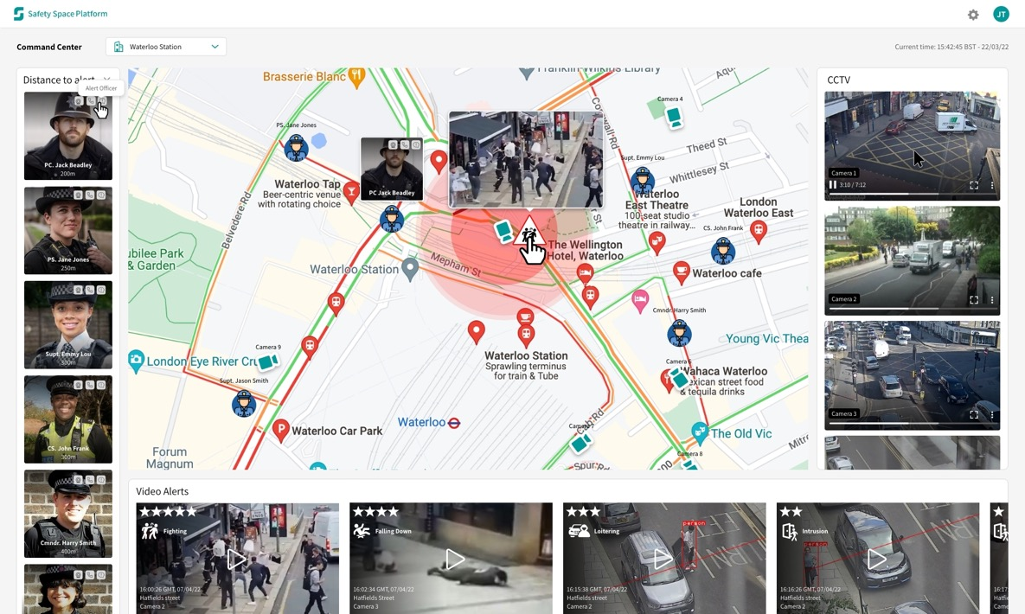
Efficient Operations with Command Center
Command Center and Op
Web-Brower Based Applications, can be accessed from anywhere with any OS
Google map view
User-friendly, actionable, & rule-based notification, supporting e-mail/SMS
Dashboard and Reporting
Mobile APP
Integration with mainstream VMS: Genetec and Milestone
Fast Response System
Violation Tracking
Risk Management
Higher Productivity
Threat Management
Efficient Operation
Public Safety

Slide 5
Key Customers & Use Cases
Operation with Advance Tooling
Local Authority and Police, UK
Loitering
Disorderly Conduct
Illegal Waste Dumping
Vandalism
Vehicle Search - License Plate Recognition
Vehicle Traffic Analysis
Perimeter Security
Loitering
Crowd Detection
People Counting
Antisocial Behavior - Violence & Fight Detection
Unattended Baggage Detection
Perimeter Security
Trespassing
Right-of-way detection
Both Independent and Centrally Managed
Incident Investigation and Risk Management
Fast Response System
Violation Tracking
Risk Management
Higher Productivity
Threat Management
Efficient Operation
Public Safety
Remark SSP provides a fast ROI and pays for itself

Slide 6
Upcoming Projects
Solutions with Advanced Analytics
UK rail network
Construction
Healthcare
Platform safety
Meta search person (wearing style, age, gender) : criminal, missing people
Meta search vehicle: color, model, license plate number
Disorderly Conduct
Vandalism
Unattended Baggage Detection
Fare evasion
Vandalism
Site safety
Perimeter Security
Trespassing
PPE detection
Excavator detection
Vehicle Detection
ANPR
Incident Investigation and Risk Management
Facial ID – Doctor validation for online medical appointments, report for attendance and timings of sessions, doctors audit trail
Medical PPE
Staff & patients check-in verifications
People Counting occupancy and waiting for queue
Site safety
Fast Response System
Violation Tracking
Risk Management
Higher Productivity
Threat Management
Efficient Operation
Public Safety
Remark SSP provides a fast ROI and pays for itself

Slide 7
Live Crowd Monitoring
Live People Counts: Multi-Zone, Egress, Ingress, and Aggregate count

Slide 8
Live Crowd Intelligence
Anonymous Detection
Crowd Flow Tracking

Slide 9
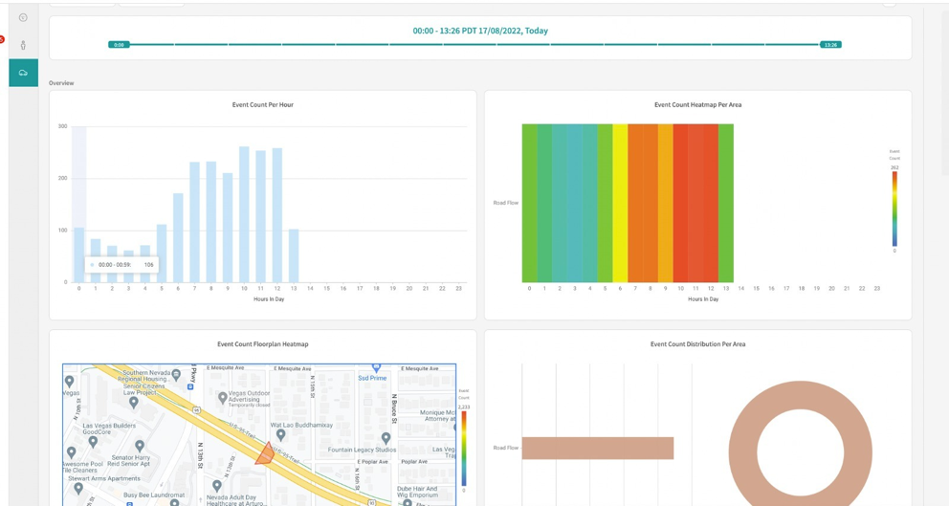
Crowd Monitoring & Analytical Dashboard
Live People Counts & ReID
Analytical Dashboard

Slide 10
Real-time Alerts – Vandalism/Graffiti
Vandalism - Graffiti Detection
Vandalism - Graffiti Detection

Slide 11
Real-time Alerts – Disorderly Conduct: Fighting & Loitering
Fighting
Loitering

Slide 12
Real-time Alerts – Slips, Trips, Falls
Slips, Trips and Falls

Slide 13
Real-time Alerts – Fire and Smoke Detection
Fire
Smoke

Slide 14
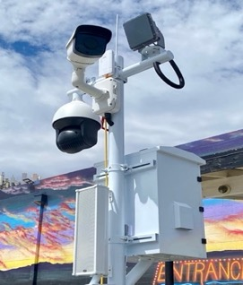
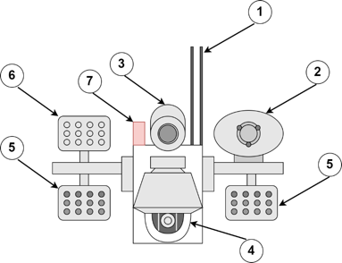
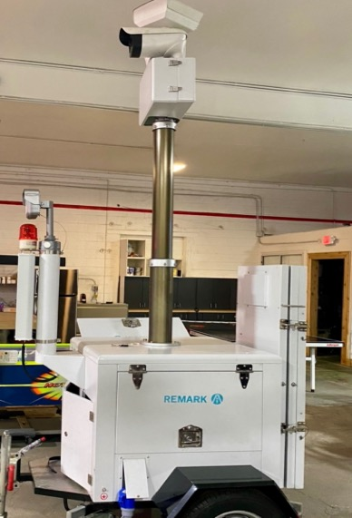
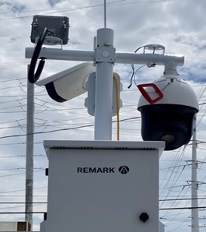
Multi-function & Long-range Surveillance with Remark Sentry
Surveillance analytics to cover a wider area as an intelligent combination of computer vision and robotic technology
4G/5G Network
Siren
Thermal Camera
PTZ Camera
IR Projector
White LED Projector
Red flashlight
Edge Computing
All-in one System
Fixed Sentry
Abnormal event detection for safety and security violations
Slips, Trips, Falls, Fire, Smoke, Intrusion, Violence
Multi-Channel Rule-based alerts
24x7 Multi-spectral Intelligent surveillance system in all weather and environmental conditions
Key Features
8
Mobile Sentry

Slide 15
Intelligent Investigation with Video Search
Person Search
Vehicle Search

Slide 16
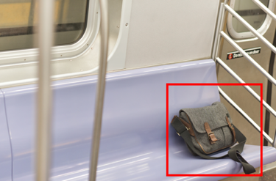
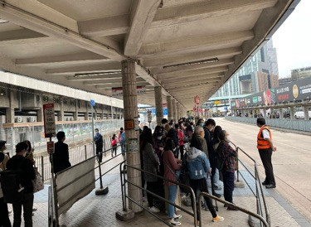
Safe and Secure Operations with Remark AI
Operations with Advance Tooling
Alerts
Intrusion
Blocklist Personal
Disorderly Conduct
Investigation & Search
Person Search
Vehicle Search
Event Tracking
Analytics
Passenger flow patterns
Alert trends – what, when, frequency
Resource Optimization
Audit & Compliance
Overcrowding
Fire & Smoke
Unattended baggage
Access violation
Cleanliness Protocol violation

Slide 17
Summary
Build Safer Communities with Remark Vision
Remark
World class proven AI platform
Extensive Expertise
Build Comprehensive Solution
Top Commitment
Efficient Operations
Enhance Productivity
Real-time situational awareness
Improve Crime/Violation Management
Enhance Training Program
Highly Trained Staff
Enhance Customer experience
Public
Improve Public Safety
Fast and Coordinated Response System
Enforce accountability

Slide 18
Our Customers and Partners
Leader in Video Analytics

Slide 19
Thank You

